Slide 1

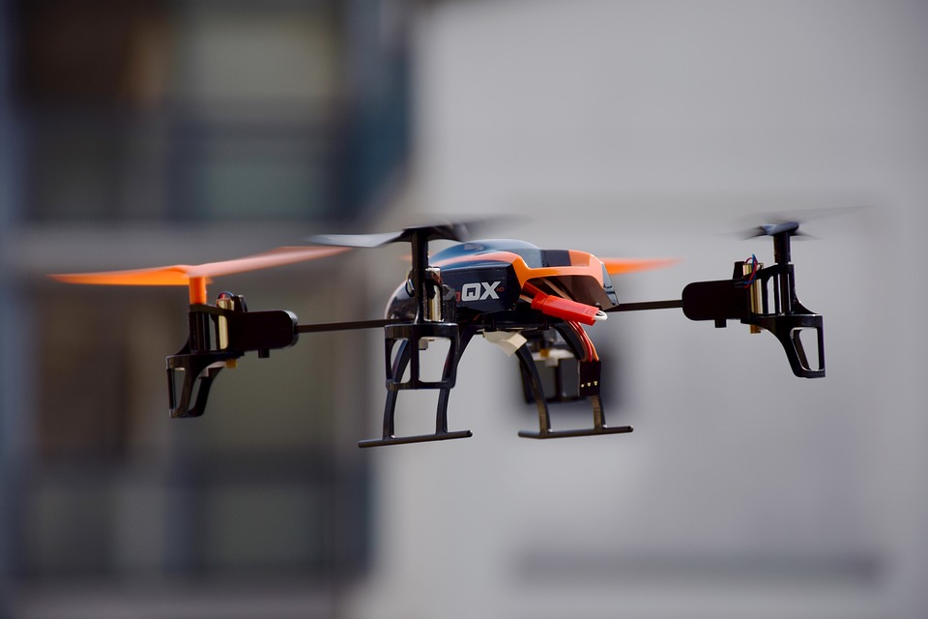
FPV-DRONES
Submitted By : Jiya Monpara
Exam No : 6045
Guide By : Prof. Jayesh Maurya

Slide 2
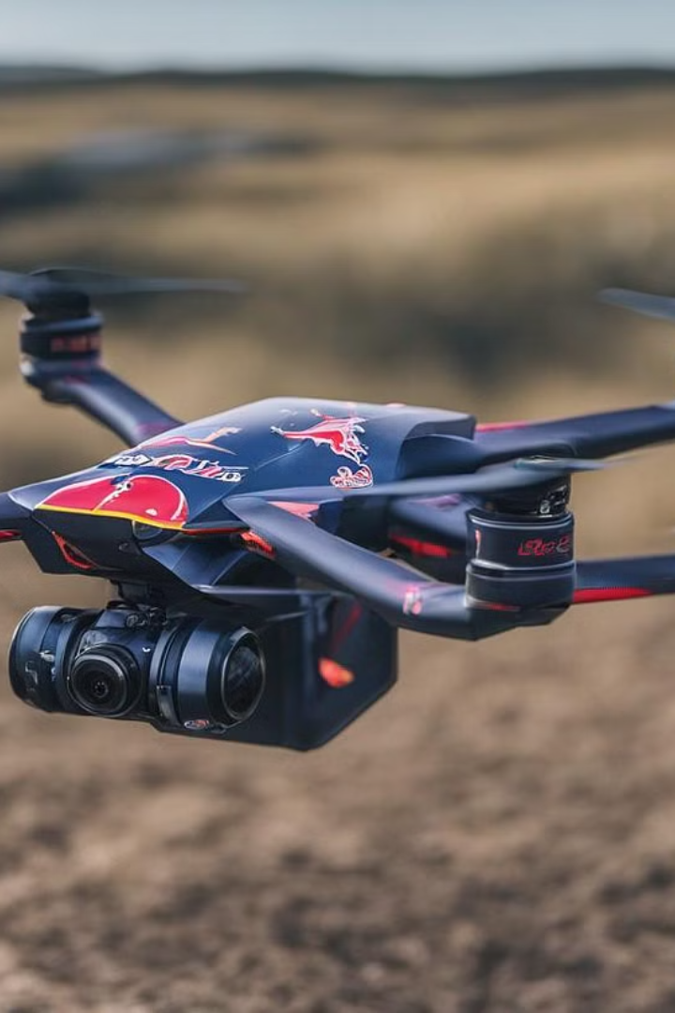
Content:-
Introduction to FPV drones
Why is FPV drones ?
How do FPV drones work ?
Components of an FPV drone
Types of FPV drones
Popular FPV drone brands
FPV drone Racing
FPV drone freestyle
FPV Drone Photography and Videography
Safety consideration for flying FPV drones
Tips for flying FPV drones
Future of FPV Drones
Benefits of using FPV drones
Limitations of using FPV drones
Conclusion

Slide 3
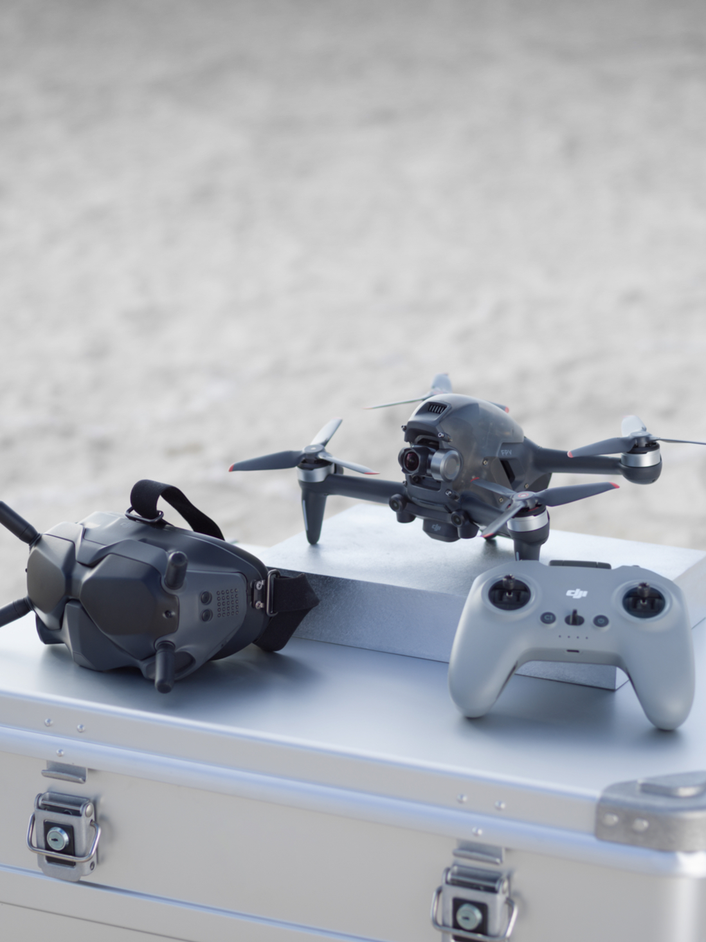
Introduction to FPV drones
FPV stands for First Person View, and it's a type of drone that lets you see what the drone sees in real-time through a video feed. An exhilarating experience like no other, FPV drones offer a thrilling perspective with agile maneuvers and breathtaking aerial views.

Slide 4
What is FPV (First Person View)?
FPV, or First Person View, is a drone flying method where the pilot sees a live video stream from the drone's perspective. FPV (First Person View) drones are remote-controlled aircraft equipped with cameras that provide a real-time video feed to the pilot, allowing them to experience the flight from the drone's perspective. These drones are popular among hobbyists, videographers, and even professional racers due to their immersive and thrilling flying experience.

Slide 5
How do FPV drones works?
First-person view (FPV) drones work by using a combination of technologies to provide the pilot with a real-time view from the drone's perspective. The key components include a camera mounted on the drone, a video transmitter, and FPV goggles or a monitor for the pilot to view the live feed. The camera captures the video feed, which is then transmitted wirelessly to the pilot's goggles or monitor, giving them a immersive view of the drone's flight.

Slide 6
Components of an FPV drone
Camera System
Video Transmitter
High-definition camera for immersive first-person view
Sends live video feed to FPV goggles or monitor
Flight Controller
FPV Goggles
Brain of the drone, controls flight and stability
Wearable display for real-time view from the drone

Slide 7
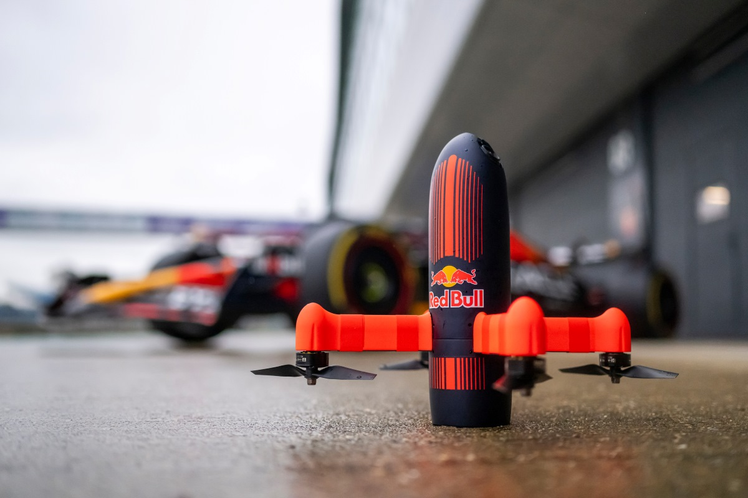
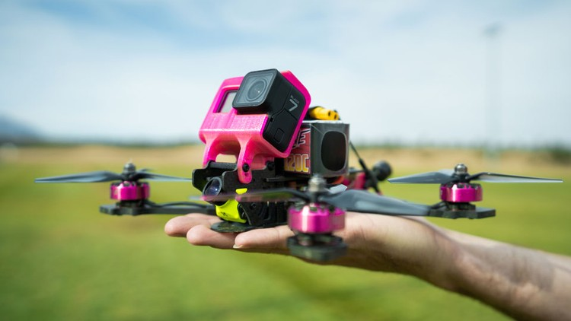
Types of FPV drones
Racing drones: Lightweight, agile, and designed for speed and maneuverability.
Freestyle drones: Versatile, capable of performing complex aerial maneuvers for creative videography.
Cinematic drones: Stable, equipped with high-quality cameras for smooth and cinematic footage capture.

Slide 8
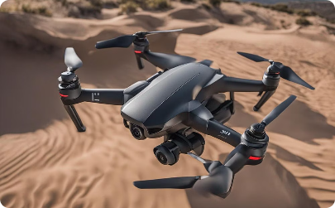
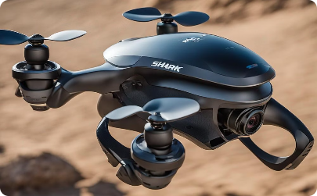
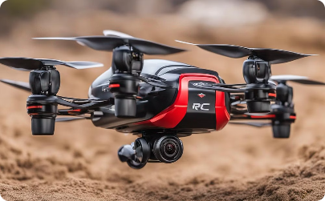
Popular FPV drone brands
DJI
Fat Shark
ImmersionRC
Leading brand with high-speed, vibrant drones.
Innovative brand known for futuristic technology and immersive goggles.
Brand renowned for agility and aerodynamic design.

Slide 9
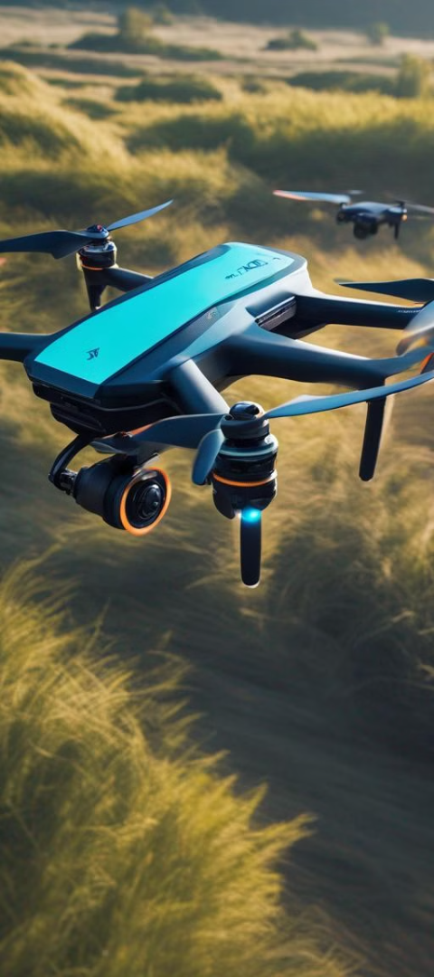
FPV Drone Racing
1
Preparation
Check drone and equipment
2
Competition
Race through designated course
3
Strategy
Plan movements and obstacles

Slide 10
FPV Drone Freestyle
Creative Flying
Acrobatic Tricks
Immersive Experience
Expressive and dynamic maneuvers
Performing flips, rolls, and inverted flights
Engaging and adrenaline-pumping flying style

Slide 11
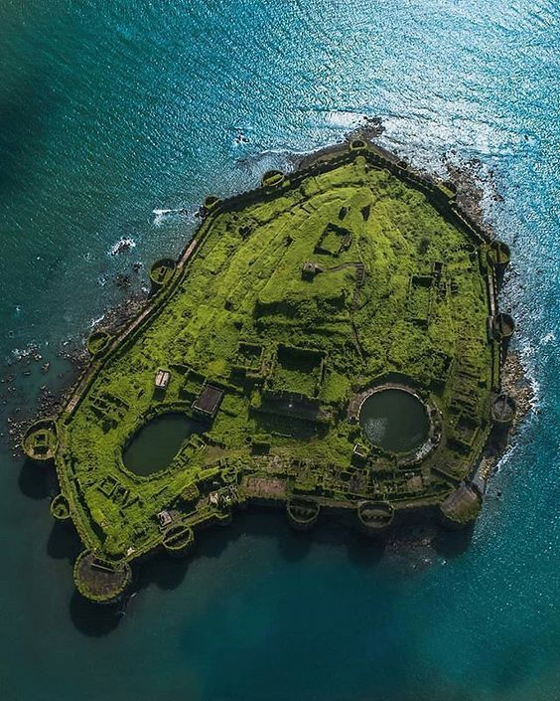
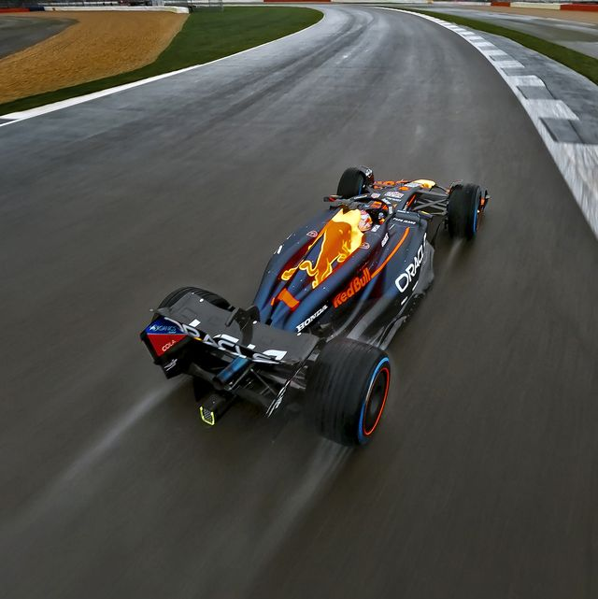
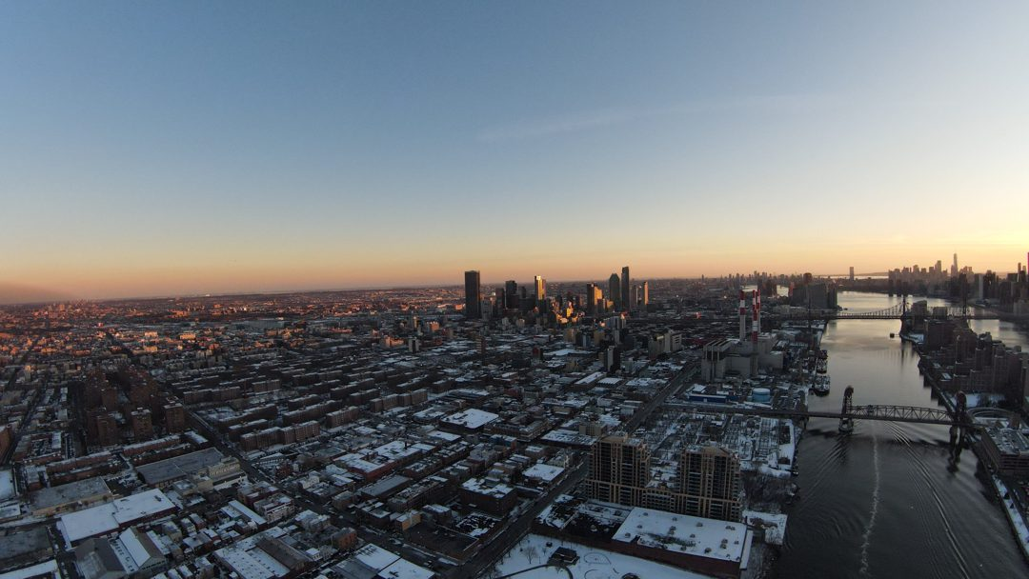
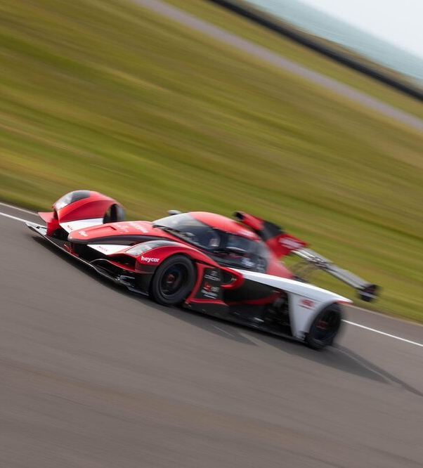
FPV Drone photography and videography
FPV drones have revolutionized the
world of photography and videography,
providing enthusiasts and professionals
with a unique perspective to capture
stunning aerial shots. With the
first-person view (FPV) capability,
drone pilots are able to immerse
themselves in the action, resulting in
dynamic and captivating footage.

Slide 12
Safety considerations for flying FPV drones
Space Awareness
Weather Conditions
Be mindful of surroundings and potential obstacles.
Check for suitable weather and wind conditions before flying.
RF Interference
Emergency Procedures
Avoid areas with strong radio frequency interference.
Know how to respond to emergencies and ensure a safe landing.

Slide 13



Tips for getting started with FPV drones
Drone Kit
Simulator
Safety Guidelines
Entry-level kit with drone, controller, and goggles
Practice flying on a simulator before real flight
Learn and follow safety guidelines for flying

Slide 14
Benefits of using FPV drones
Immersive Experience
Aerial Photography and Videography
Using FPV drones provides an immersive flying experience, allowing pilots to feel like they are actually in the cockpit, providing a thrilling and realistic flying experience unlike any other.
FPV drones enable stunning aerial photography and videography, capturing unique perspectives and breathtaking shots that were once only possible with expensive helicopters or planes.
Learning and Skill Development
Thrilling Sport and Community
FPV drone racing and freestyle flying have created a thriving community, bringing together enthusiasts to compete, collaborate, and share experiences, adding a social and competitive aspect to the hobby.
Utilizing FPV drones offers a platform for learning, skill development, and gaining a deeper understanding of aerodynamics, electronics, and engineering, making them an exciting tool for educational purposes.

Slide 15
Limitations of using FPV drones
Limited Flight-Time
Risk of Accidents
PV drones typically have shorter flight times compared to other types of drones, mainly due to the extra power consumption of the FPV equipment such as the camera, video transmitter, and goggles.
FPV flying can be more prone to accidents compared to line-of-sight (LOS) flying. The pilot's limited field of view through the FPV goggles makes it harder to perceive obstacles or other aircraft in the vicinity, increasing the risk of collisions.
Complexity
Cost
Flying an FPV drone requires a certain level of skill and understanding of both drone piloting and FPV equipment. The need to handle various components such as the drone itself, the FPV camera, video transmitter, and FPV goggles can be intimidating for beginners.
Building or purchasing a high-quality FPV drone setup can be expensive, especially if you want top-of-the-line components for optimal performance. Additionally,
Maintaining and repairing FPV equipment can incur additional cost over time.

Slide 16
Future of FPV drones
Advancements in
technology
Regulatory Changes
and Integration
Expanding
applications
The future of FPV drones is intertwined with technological innovations.
influenced by regulatory changes and integration into existing airspace systems.
see an expansion of applications across various industries.

Slide 17
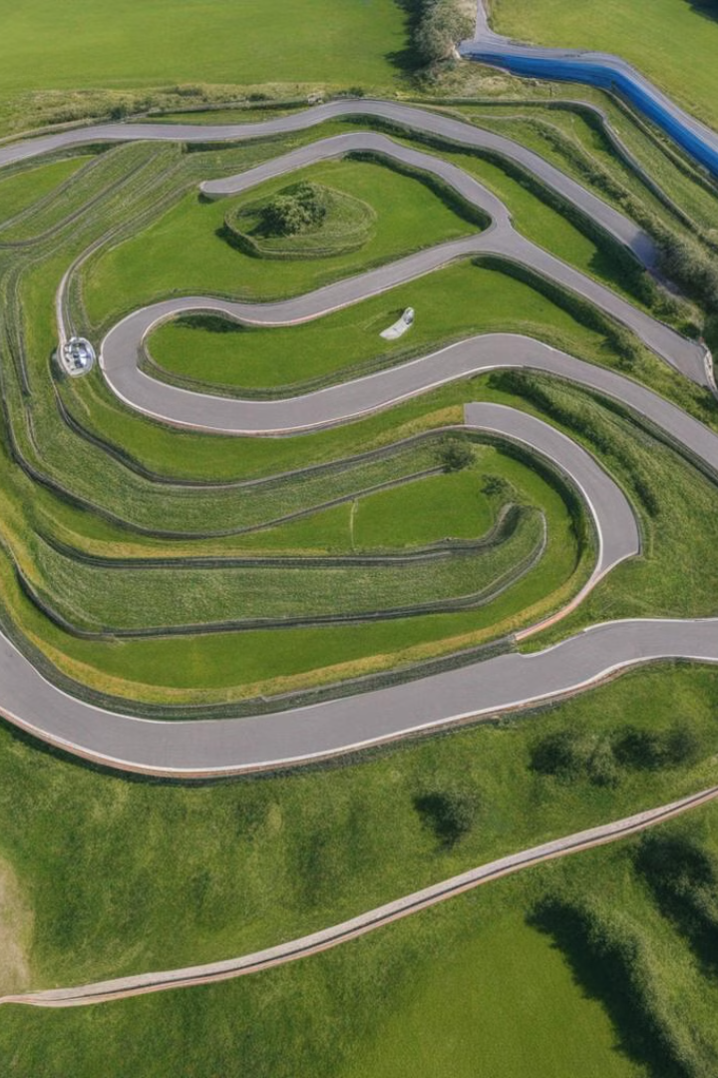
Conclusion and resources
In conclusion, FPV drones offer an smooth and immersive flying experience that has captured the imagination of hobbyists and enthusiasts worldwide. However, they come with their own set of disadvantages that pilots need to consider.

Slide 18
References
https://insidefpv.com/
https://en.wikipedia.org/wiki/First-person_view_(radio_control)
https://www.engineersgarage.com/
https://www.youtube.com/@lourrutiappt
https://www.youtube.com/@man.fromearth

